Slide 1
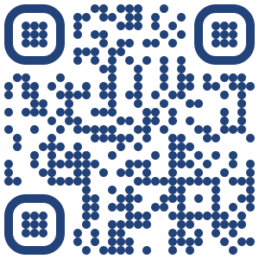
Understanding variability in response to therapy across patients with colorectal cancer metastasizing to liver
Adam Wojtulewski
Moffitt Cancer Center
Machine Learning Department
Karolak Lab

Slide 2
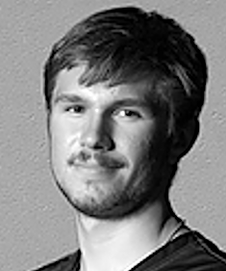
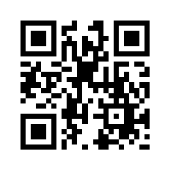
About me
Adam Wojtulewski
Completed International Baccalaureate (IB) Program at Palm Harbor University High School in May 2021
Third year undergraduate at the University of Florida (UF); graduate December 2024
Major in Computer Science and Minor in Artificial Intelligence
President of the Polish Student Association (POLSA) at UF
Took this internship opportunity to have a hands-on application of machine learning approaches
LinkedIn QR Code

Slide 3
Understanding the problem
Colorectal cancer (CRC) is the second leading cause of cancer related mortality in men and women combined
Patients with metastatic CRC (mCRC) have an very poor survival rate of as low as 14% at 5-years
Of which, liver metastases account for a large portion of the deaths
Effective chemotherapy agents and novel systemic therapies improve these numbers
However, there is a high inter- and intra-tumoral heterogeneity
Moreover, patients with similar mCRC features still respond differently to treatment

Slide 4
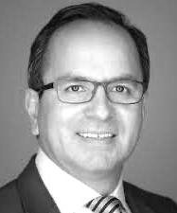
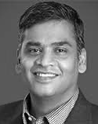
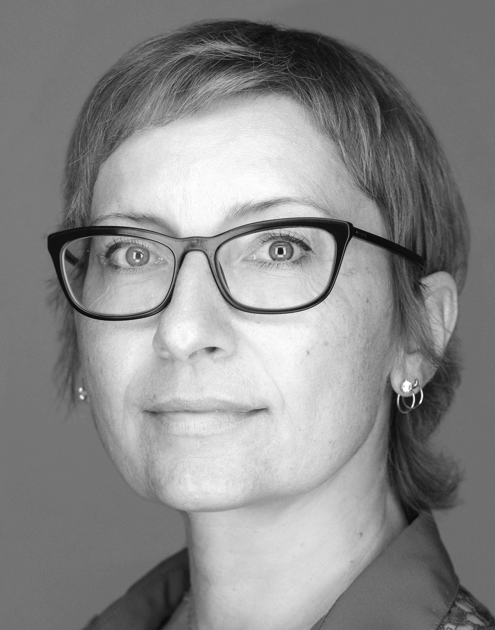
What needs to be researched
There is an urgent need to understand the variability in response to therapy across patients with similar cancer features
Can we predict response to therapy by integrating clinical, morphologic, and molecular factors (collaboration: Anaya, Balagurunathan, and Karolak)
The goal of this study is to take the first step and understand the variability in response using public sequencing data

Slide 5
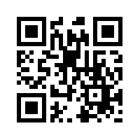
Materials and methods
Datasets
Data Pre-processing
Data visualization
K-Means Clustering
Random Forest Classifier
Artificial Neural Networks (Deep Learning)
Model verification
Github QR Code
https://github.com/AdamWojtul28/Moffitt-Data-Analysis

Slide 6
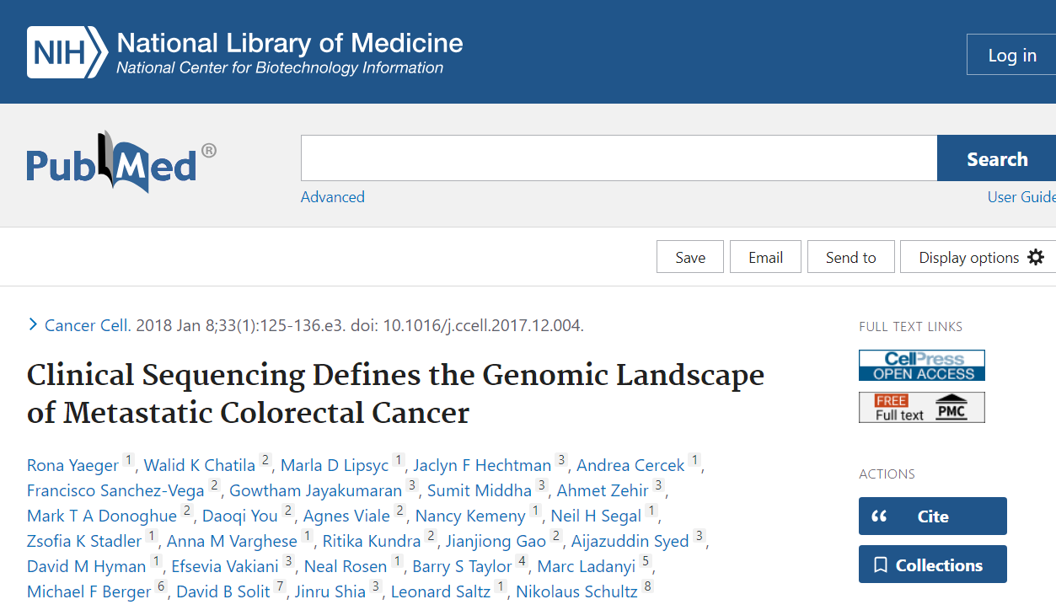
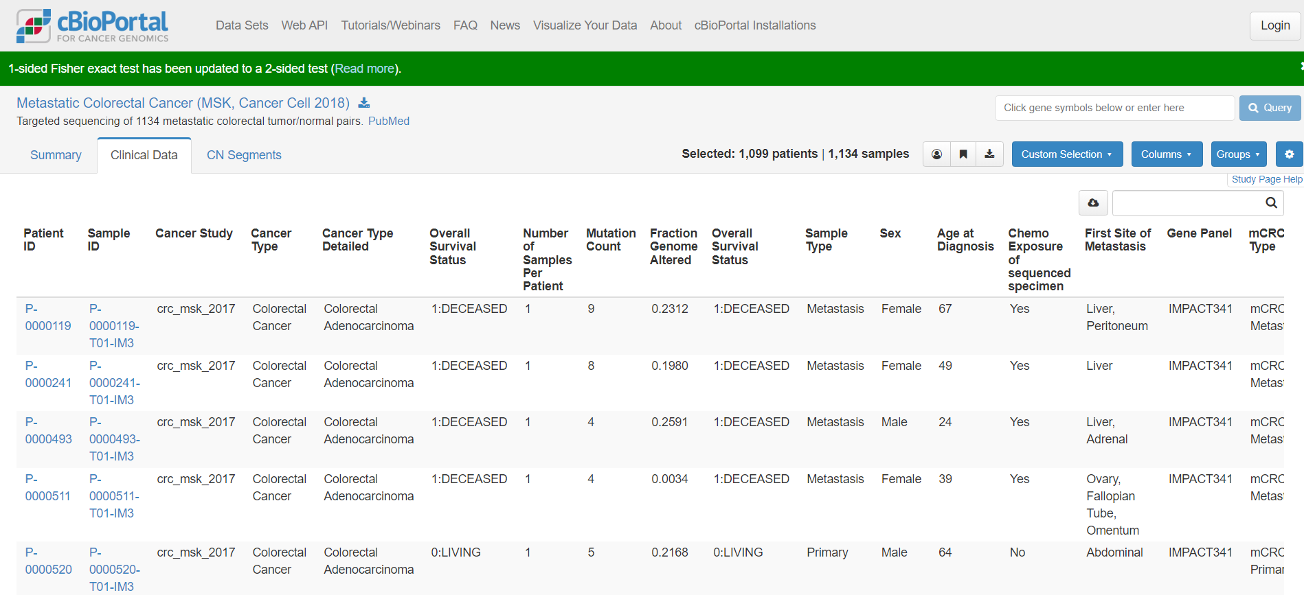
Datasets

Slide 7
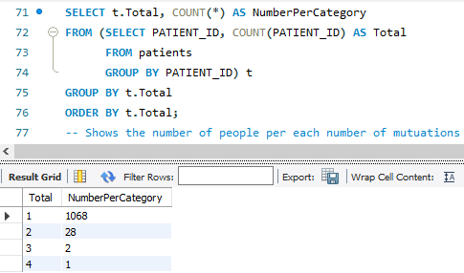
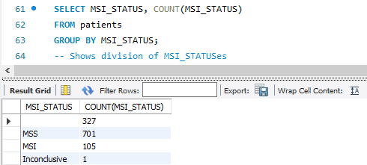
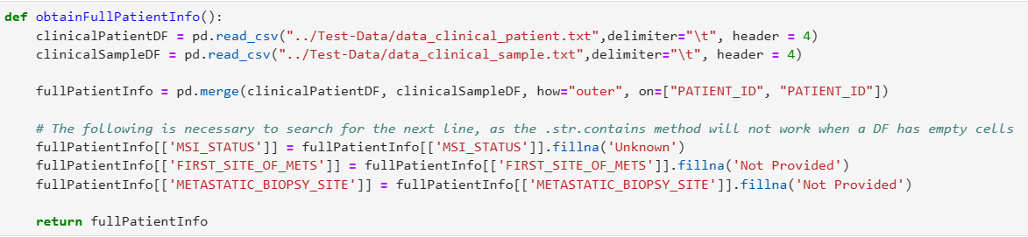
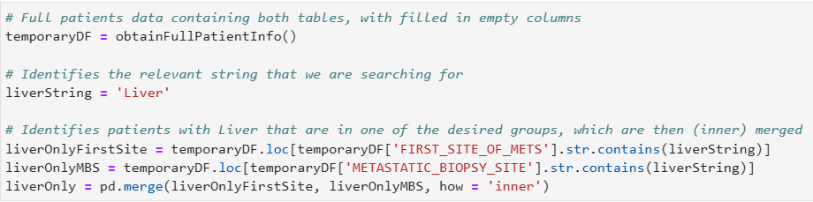
Data Pre-processing (Part 1)
Understanding the datasets
Deciding which tables to use
Merging data tables
Eliminating blank cells
Isolating only Liver MS patients

Slide 8
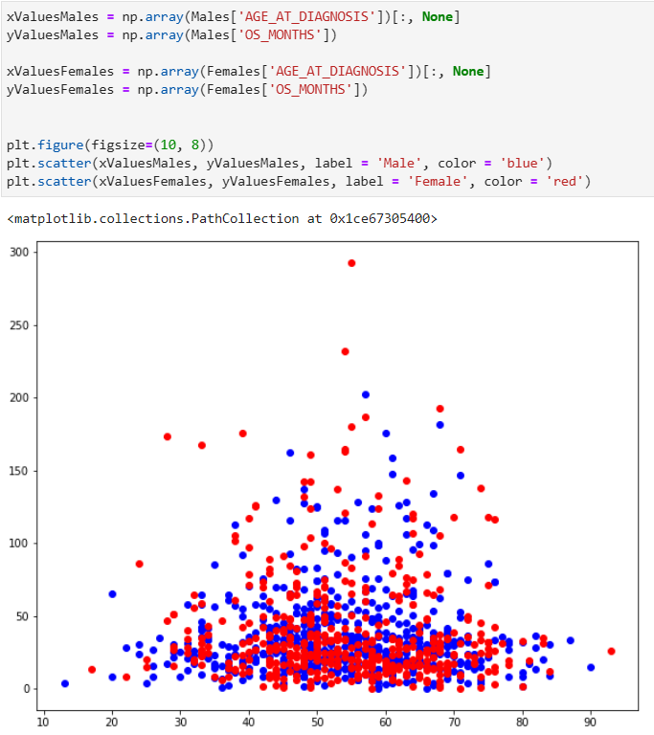
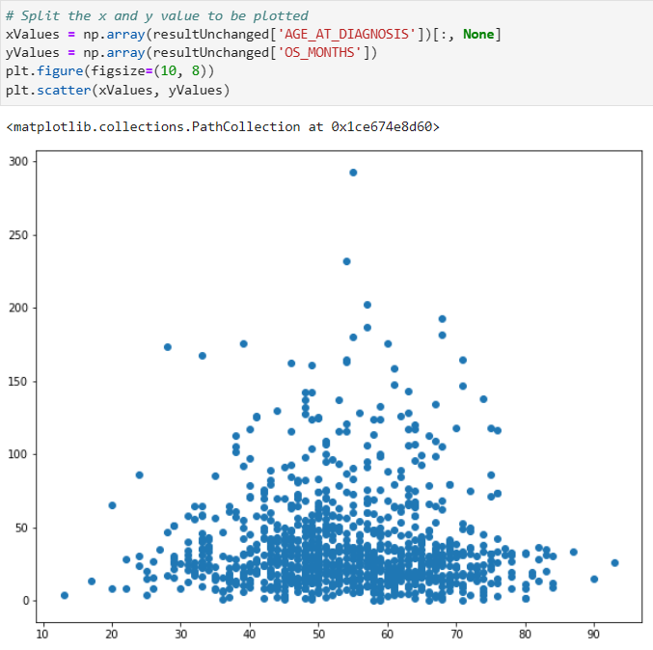
Data visualization: Pyplot
Basic form of visualization
Used to potentially visualize general trends on the entire dataset as a whole
Manually split dataset according to desired needs

Slide 9
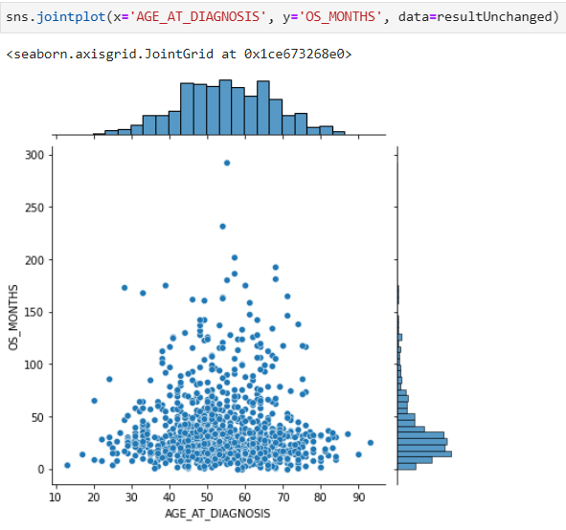
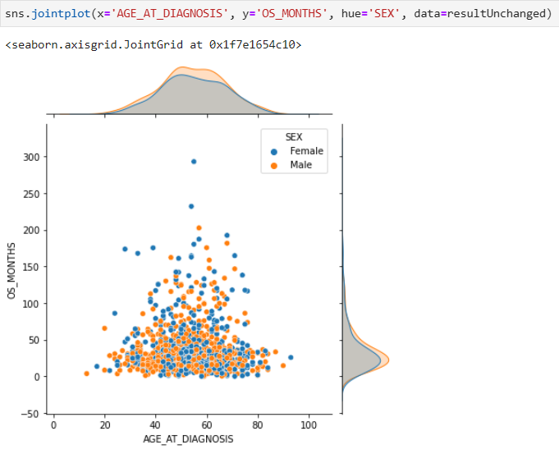
Data visualization: Seaborn
More advanced form of visualization
Used to create more complex graph types
Dataset can be split using the parameters in the graph
Eliminates need for manually splitting data

Slide 10
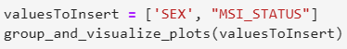
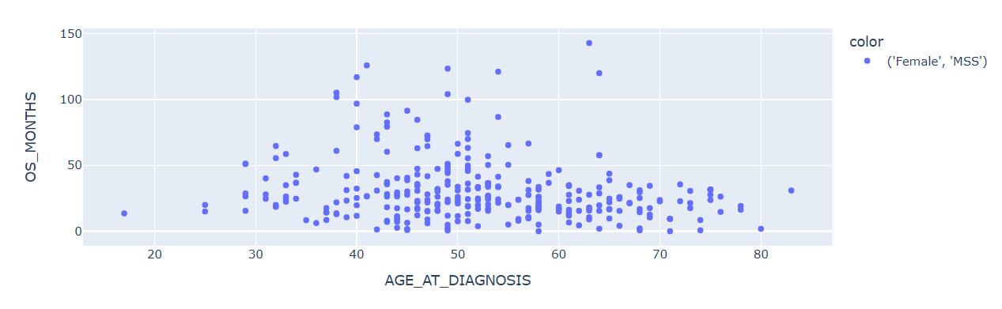
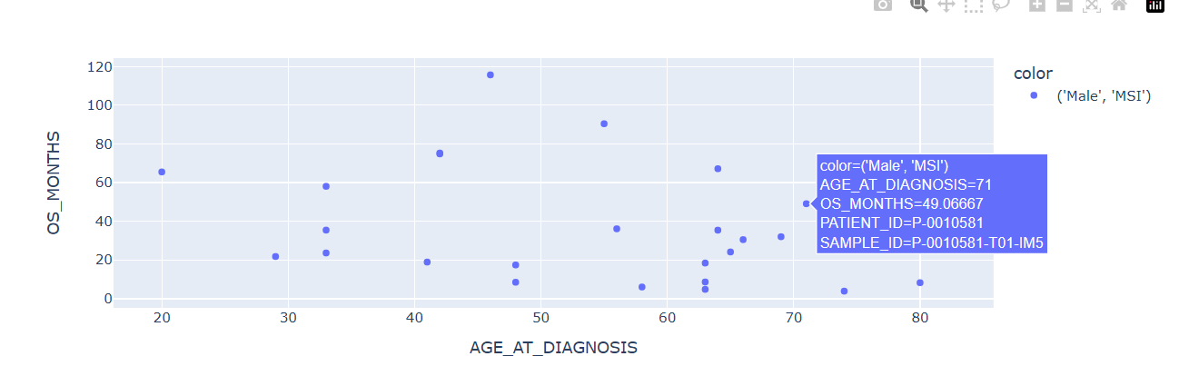
Data visualization: Plotly
Previous 2 approaches have drawbacks:
Neither produces interactive plots
To much data
Function that incorporates Plotly:
Splits data according to parameters
Produces interactive plots for each group

Slide 11
K-Means Clustering

Slide 12
Random Forest Classifier

Slide 13

How Neural Networks Work

Slide 14
Artificial Neural Networks (Deep Learning)

Slide 15
Model verification

Slide 17
Future areas of exploration
Additional verification methods for models developed
F1 Score, AUC-ROC, varying threshold
Transfer learning to Moffitt Data
Development of a self-learning interface to support clinical decision making

Slide 18
Acknowledgements
This internship would not be possible without three main groups:
Family
Machine Learning Department, especially Doctor Karolak and my team members
Moffitt Cancer Center as a whole

Slide 19
Thank you
Github QR Code
LinkedIn QR Code
Questions?

Slide 20
Sources Consulted
https://www.cancer.gov/publications/dictionaries/cancer-terms/def/metastasis
https://bjssjournals.onlinelibrary.wiley.com/doi/10.1002/bjs5.50341#:~:text=Metachronous%20metastasis%20was%20defined%20as,mm%20of%20the%20resection%20margin.
https://www.ncbi.nlm.nih.gov/pmc/articles/PMC3349572/#:~:text=%22Synchronous%20metastasis%22%20and%20%22synchronous,of%20the%20primary%20colon%20cancer.

